Slide 1
"Find your ChatMate" App
By Fedor Sharov

Slide 2
Contents
About the project
Project goals
Architecture
Used technologies
Business scenarios

Slide 3
About the project
“Find your ChatMate” App is an app for finding your most suitable chatmates in VK based on chosen categories.
Link to the app:
34.136.208.204:8080
Link to the project github page:
https://github.com/feduuk/app

Slide 4
Project goals
Learn new skills with JAVA programming language and Spring framework;
Acquire knowledge of REST API and microservice architecture;
Practice with gitflow

Slide 5
Architecture
Project modules(microservices):
Storage
In this module we persist data received from web module in postgresql database and send it back.
Web
In this module we get token for VK account from a user. Get information about friends and their groups from user account with help of VK API. Get and send the same information to storage microservice. Process this information and get list of suitable chatmates.

Slide 6
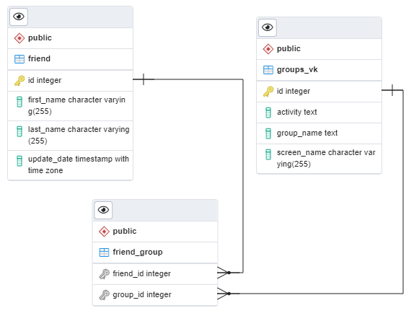
Tables

Slide 7
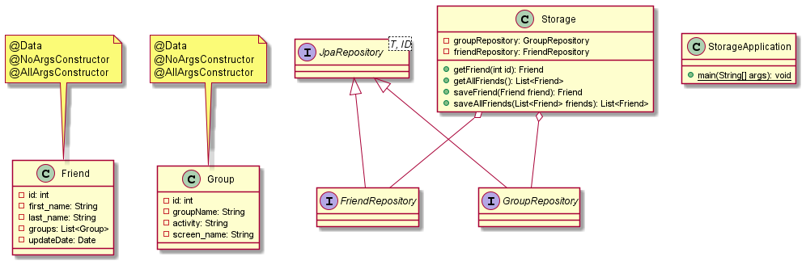
Storage. Class diagram

Slide 8
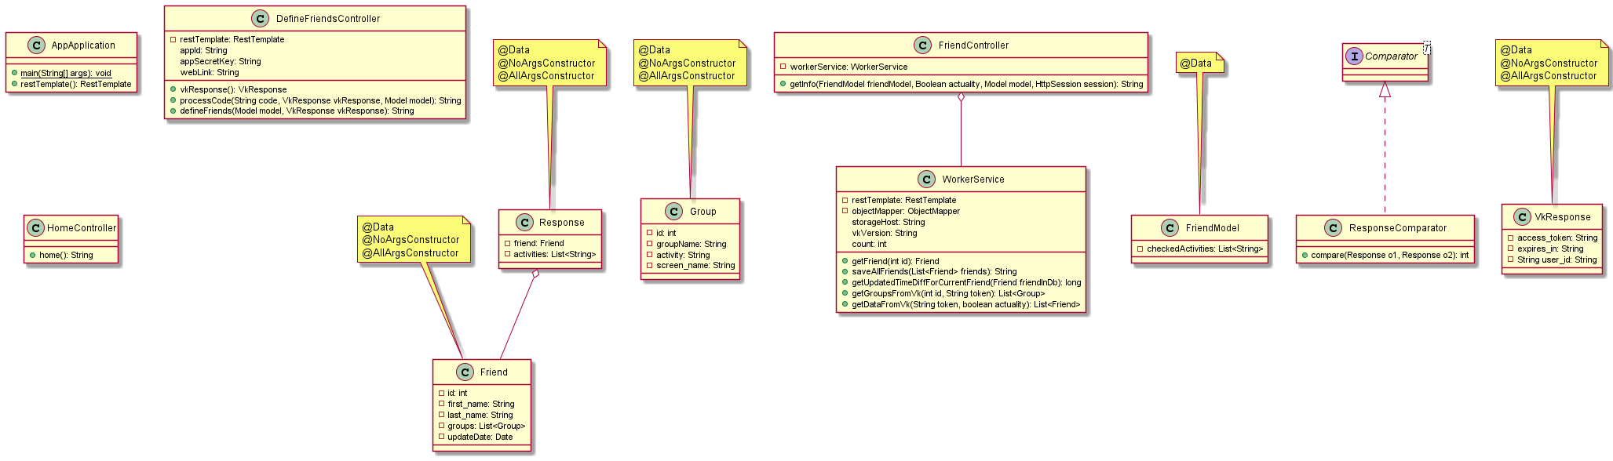
Web. Class diagram

Slide 9
Application tasks
Authorize user in VK and get access to use data.
Get user to choose categories with which to search for chatmates. These categories are used to check if a friend is having a group with such category.
Store information i.e. groups and friends from VK in database.
Check time to choose when load data from VK or database, because loading data from VK takes longer time.
Based on the given information find friends and present them in a list with the most suitable friend in the top and less in the bottom.
Get links to their VK pages and groups which have chosen category.

Slide 10
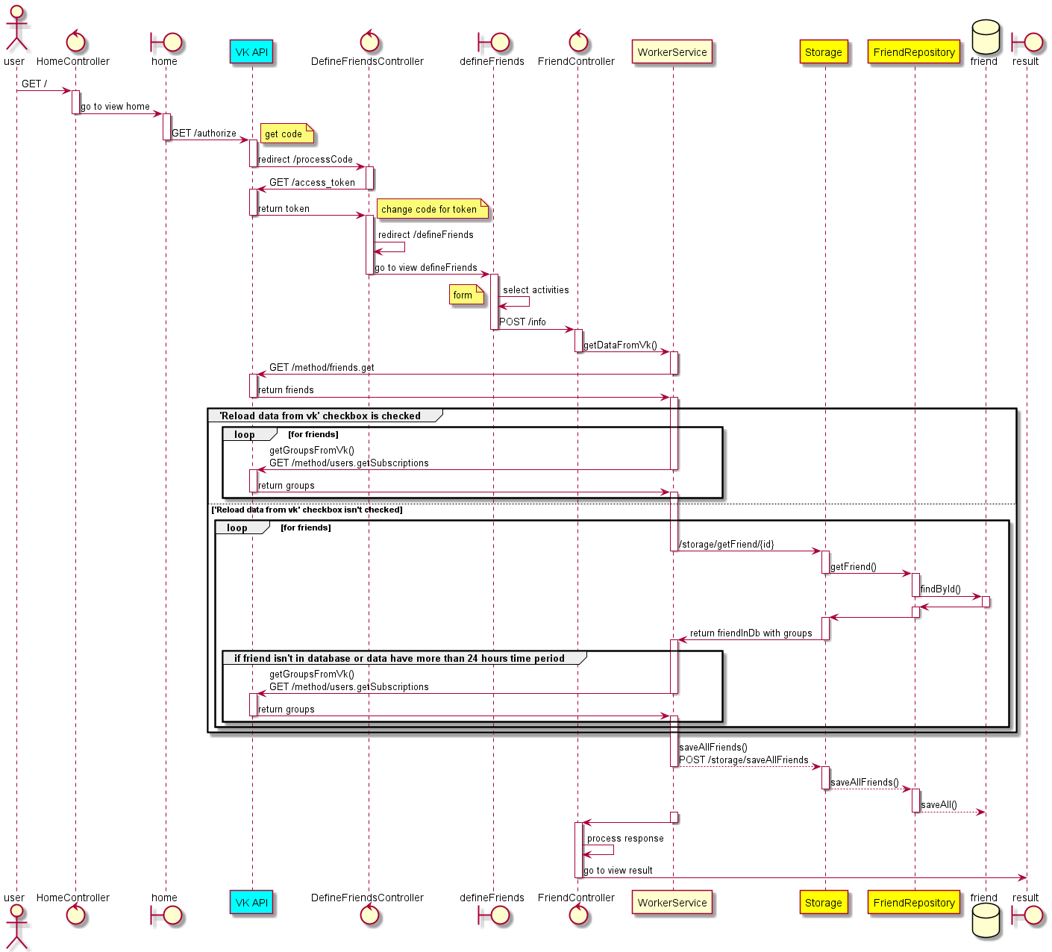
Sequence diagram

Slide 11
Used technologies
Java
Postgresql
Spring Boot
Spring Data JPA
Spring MVC
Thymeleaf
Jackson
HTML
Bootstrap
Lombok
Docker
Kubernetes
Google Cloud
VK API

Slide 12
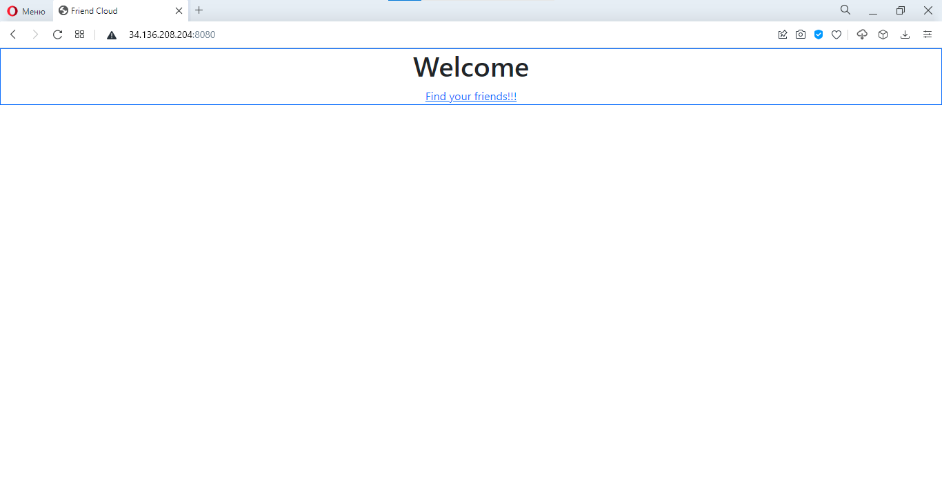
1. Start page

Slide 13
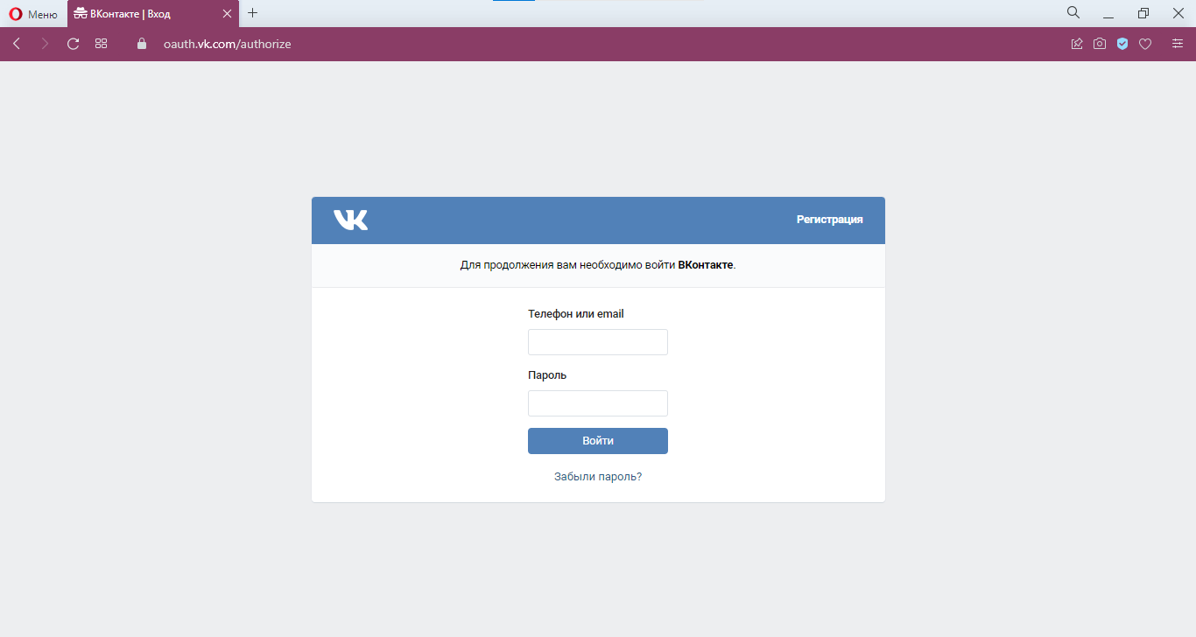
2. Authorization in VK

Slide 14
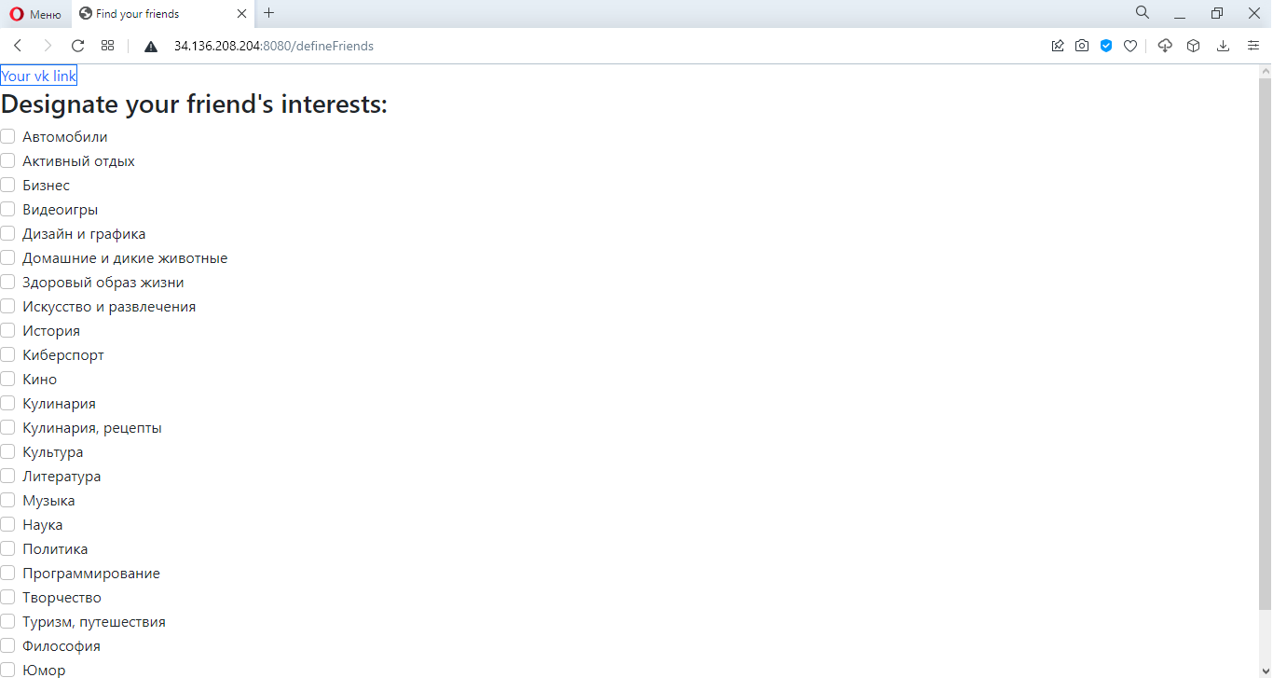
3. Page where you choose interests to find chatmates

Slide 15
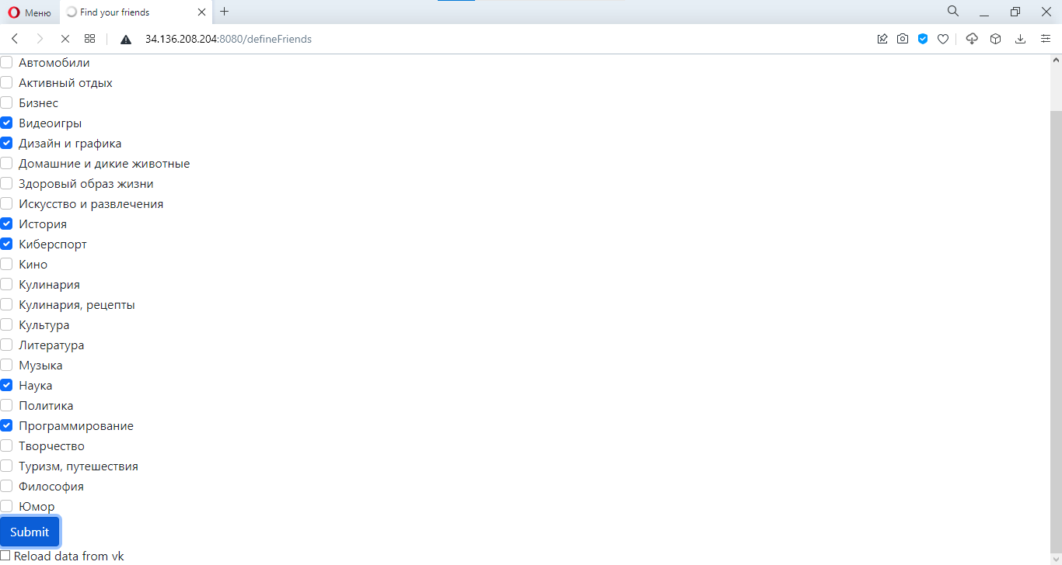
4. If checkbox under submit button is checked then use data only from vk

Slide 16
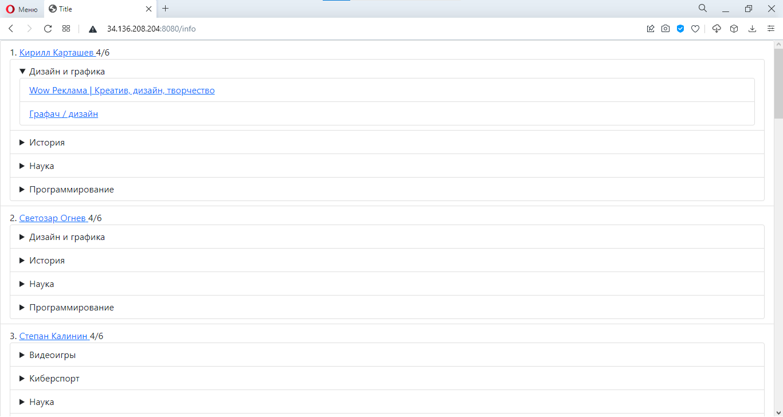
5.1. List of chatmates

Slide 17
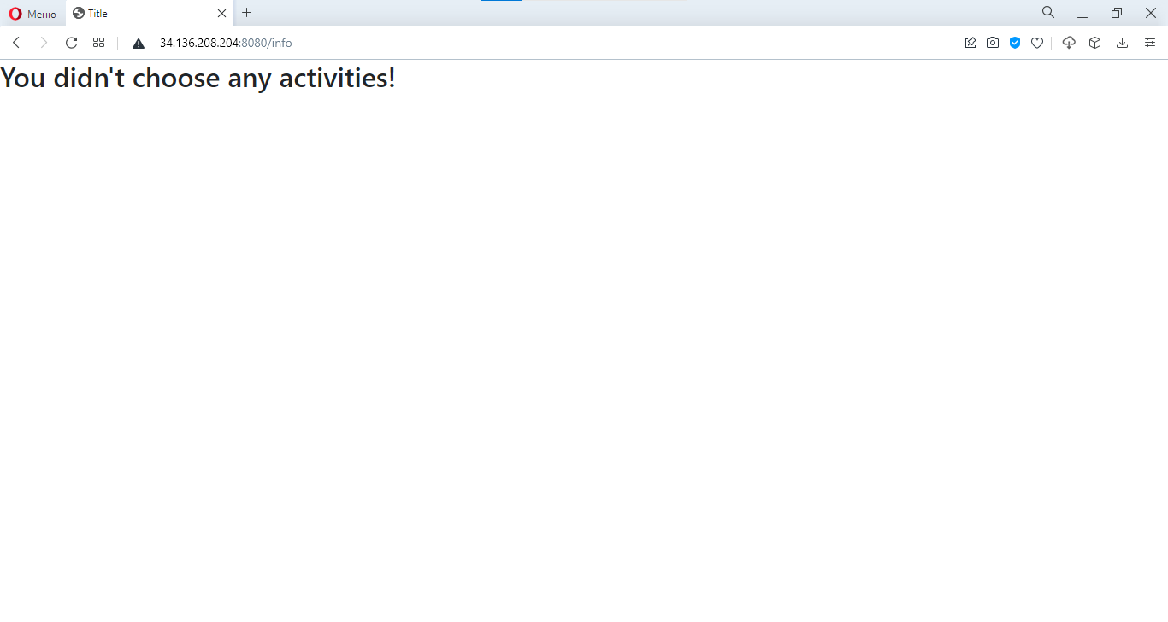
5.2. If no interests were chosen

Slide 18
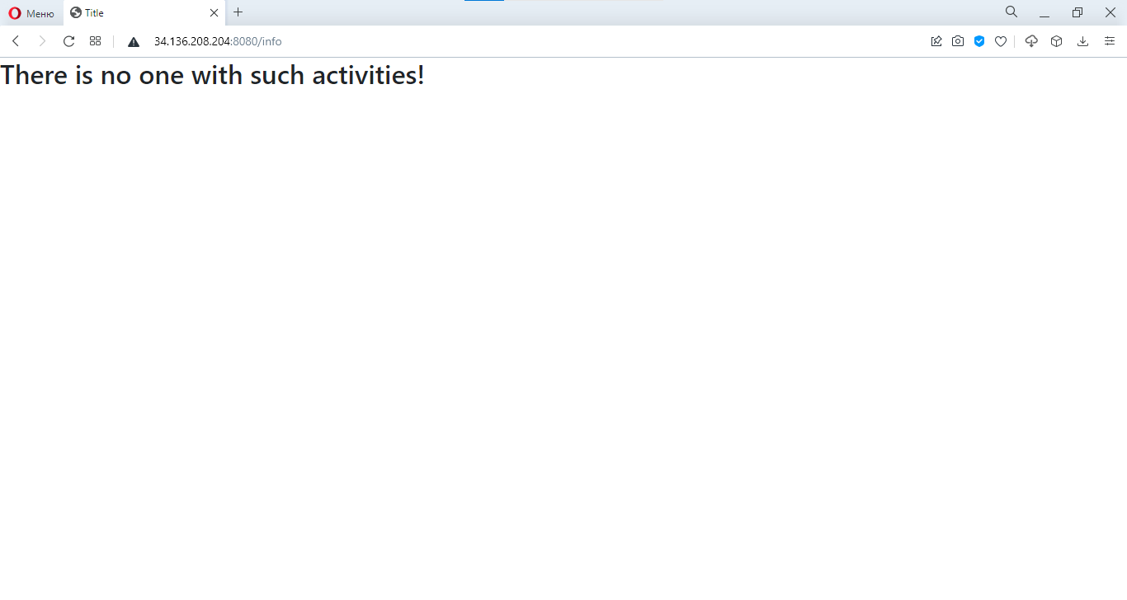
5.3. If no one was found

